Slide 1




Slide 2
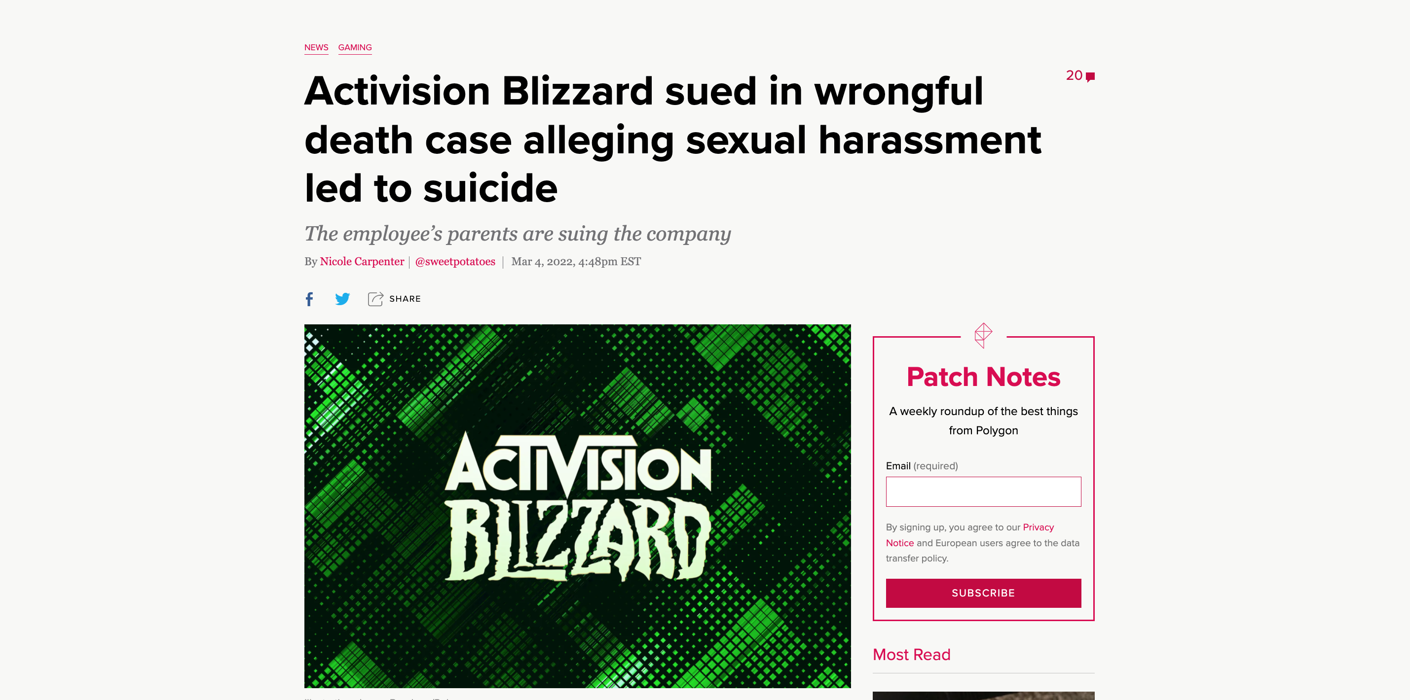

Slide 3

Sophi. comes as an App that you can always carry with you. After setting up your account, you can immediately start talking to it. The Interface is very simple and intuitive. Simply write your message and Sophi. will answer you immediately.
Sophi. was built on three important pillars.
Total Privacy
Every piece of data is anonymous.
Rights
Protects employees that suffer from sexual harassement, discrimination, racism, sexism and so on.
Responsibility
Sophi trains, tests and educates all individuals to raise awareness and productivety .

Slide 4
An AI that walks you through any work-related crisis.
Sophie is your own personal advisor. Whether you got discriminated against, Harassed, unfairly treated. Sophie will listen to you and provide you with adequate and appropriate advice. Sophie will not only guide you and suggest how you can personally and formally react to the issue at hand. But it will also gather anonymous Data, categorise it and present it as an Index to the HR department. Which can serve as an Indicator on how well or bad specific departments are doing in specific topics like discrimination and sexual harassment.

Slide 5

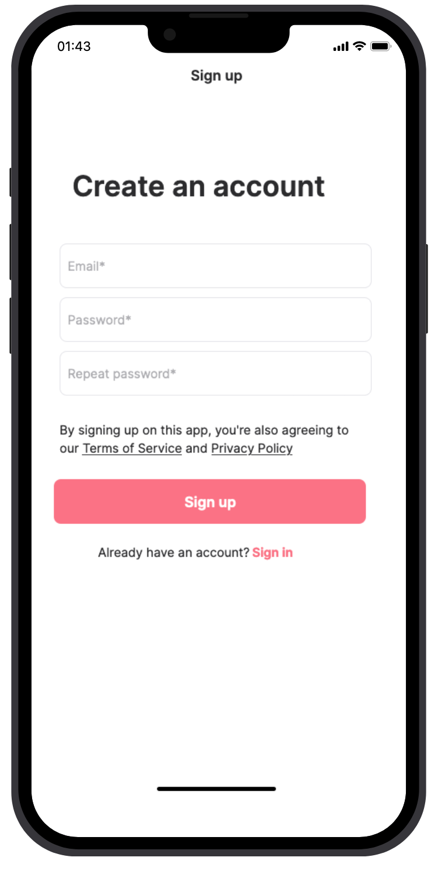
HOW IT WORKS

Slide 6
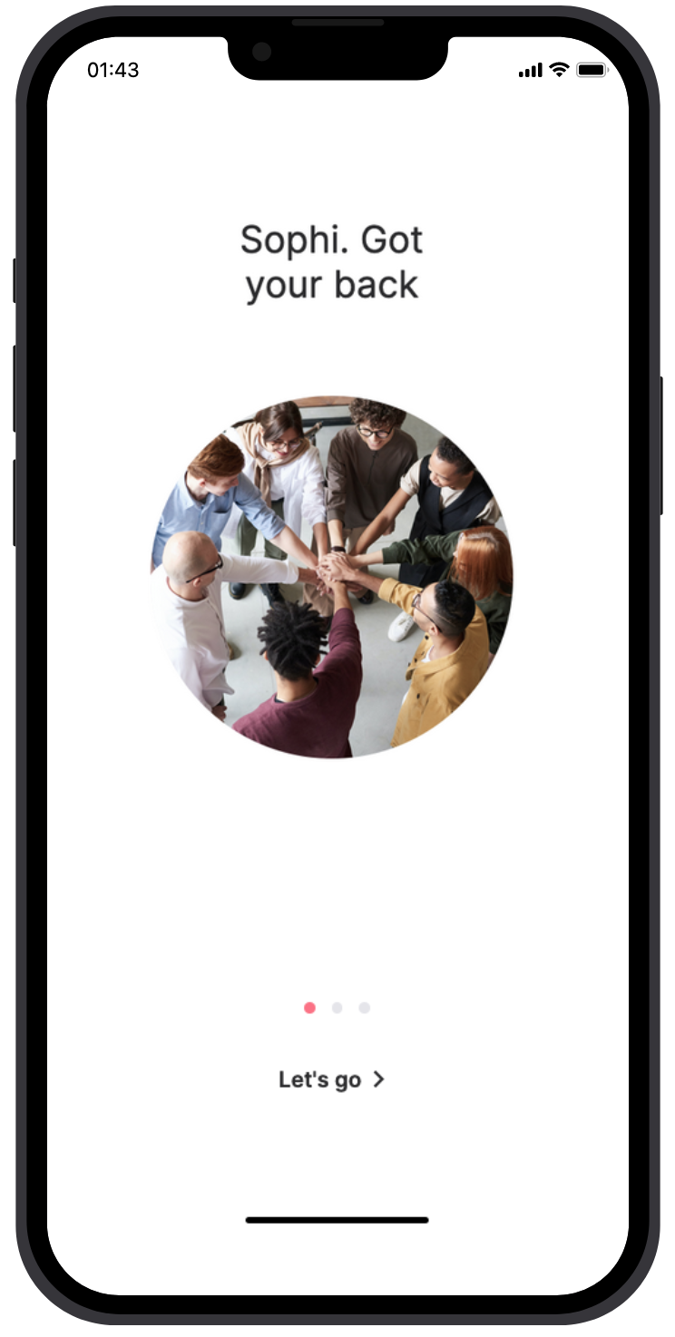
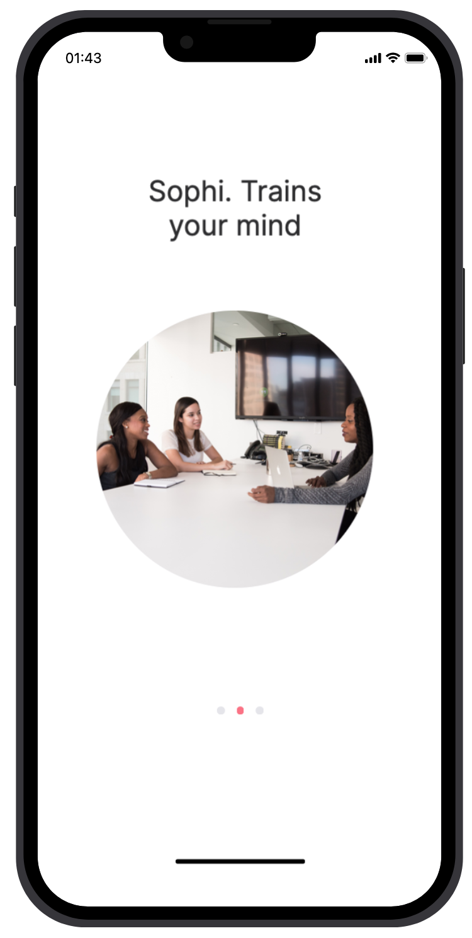
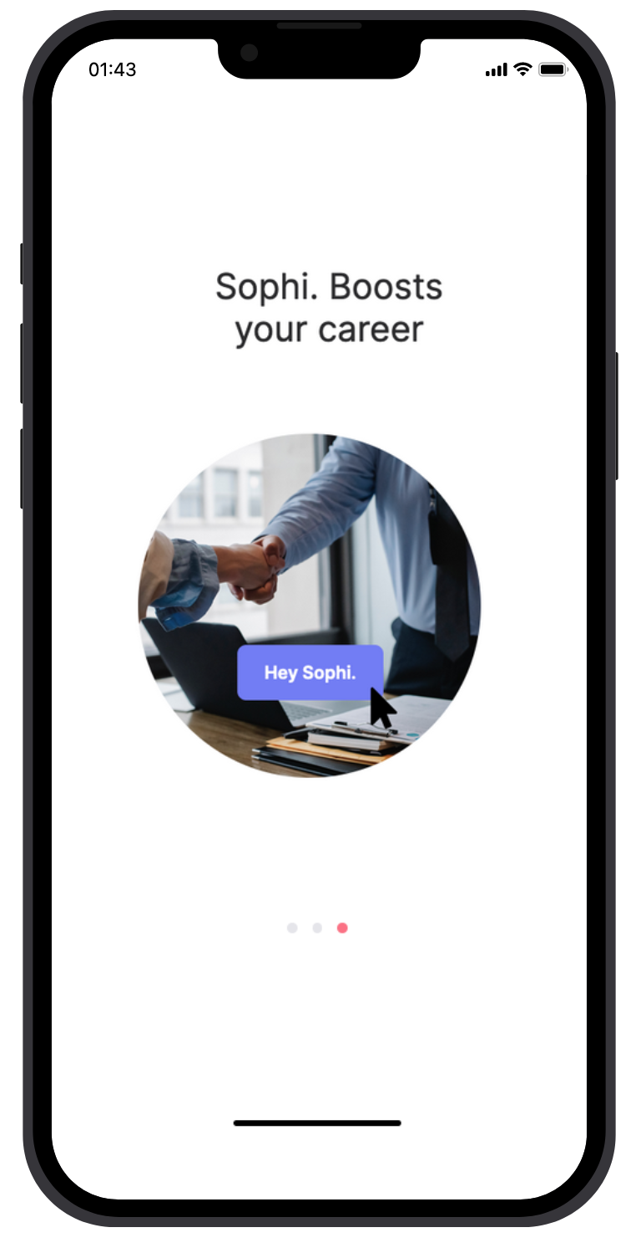

Slide 7
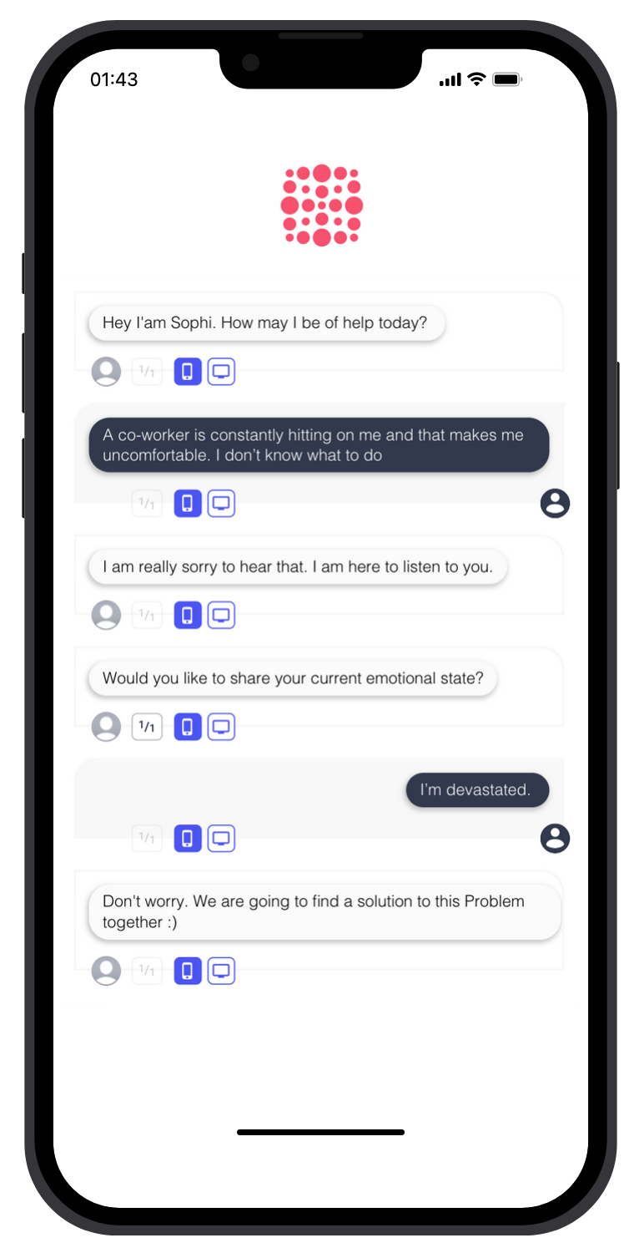
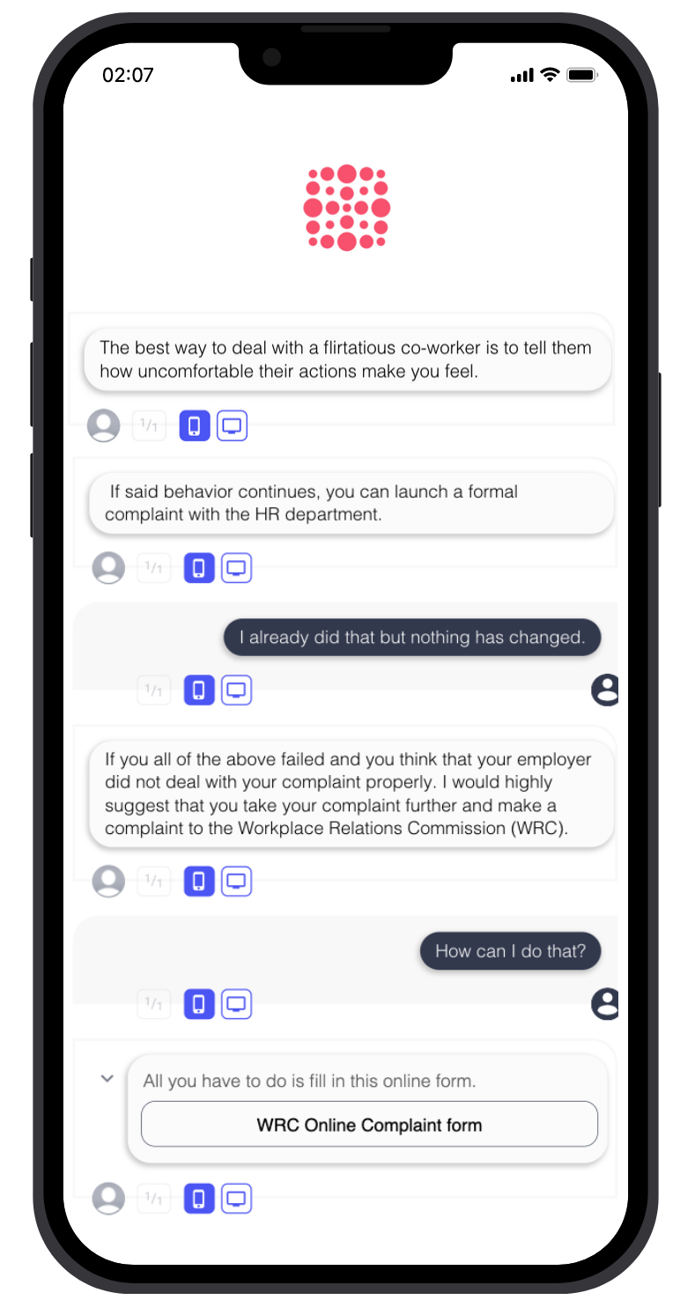
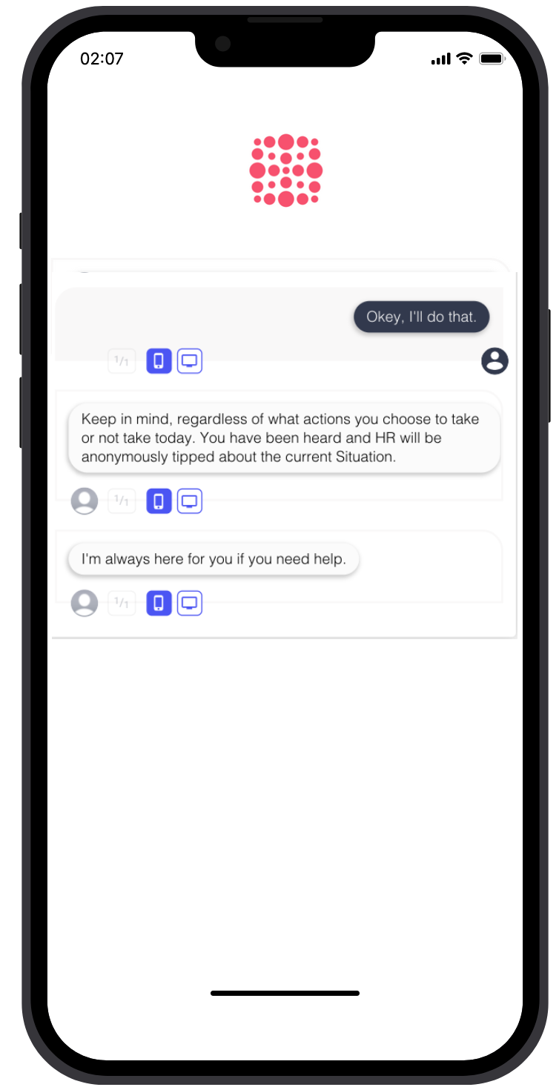

Slide 8
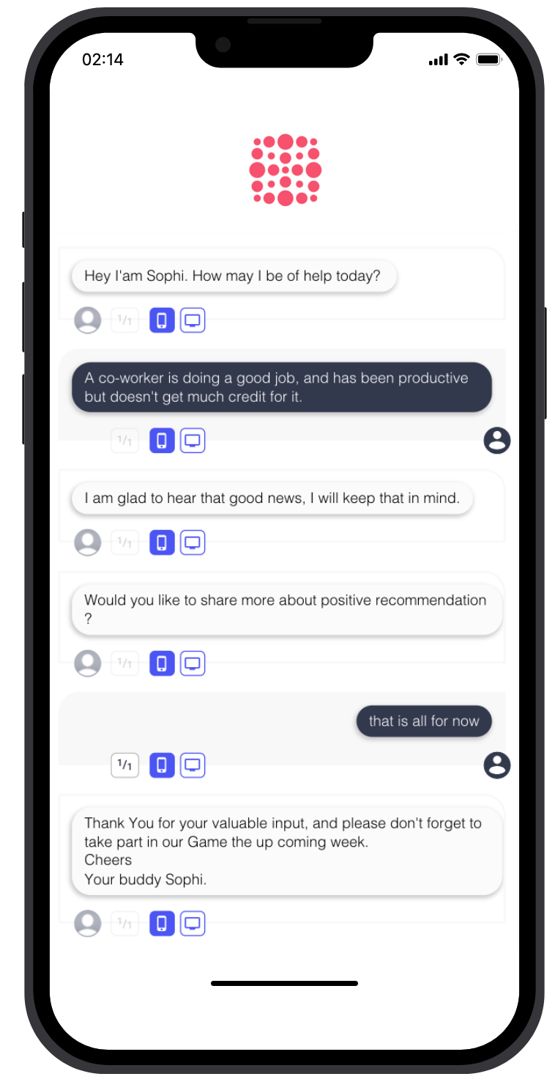
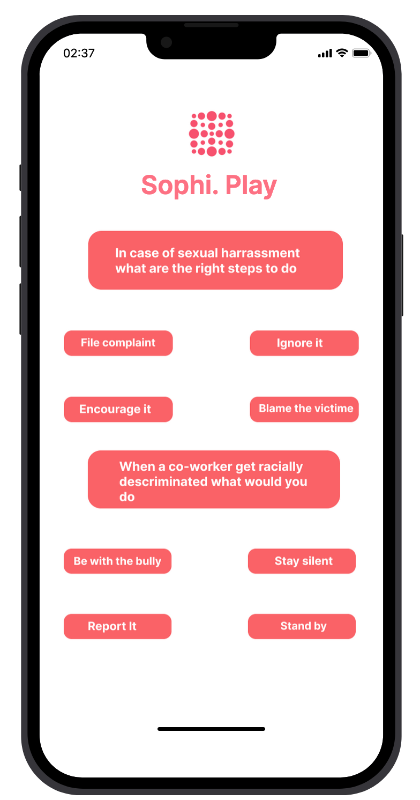

Slide 9
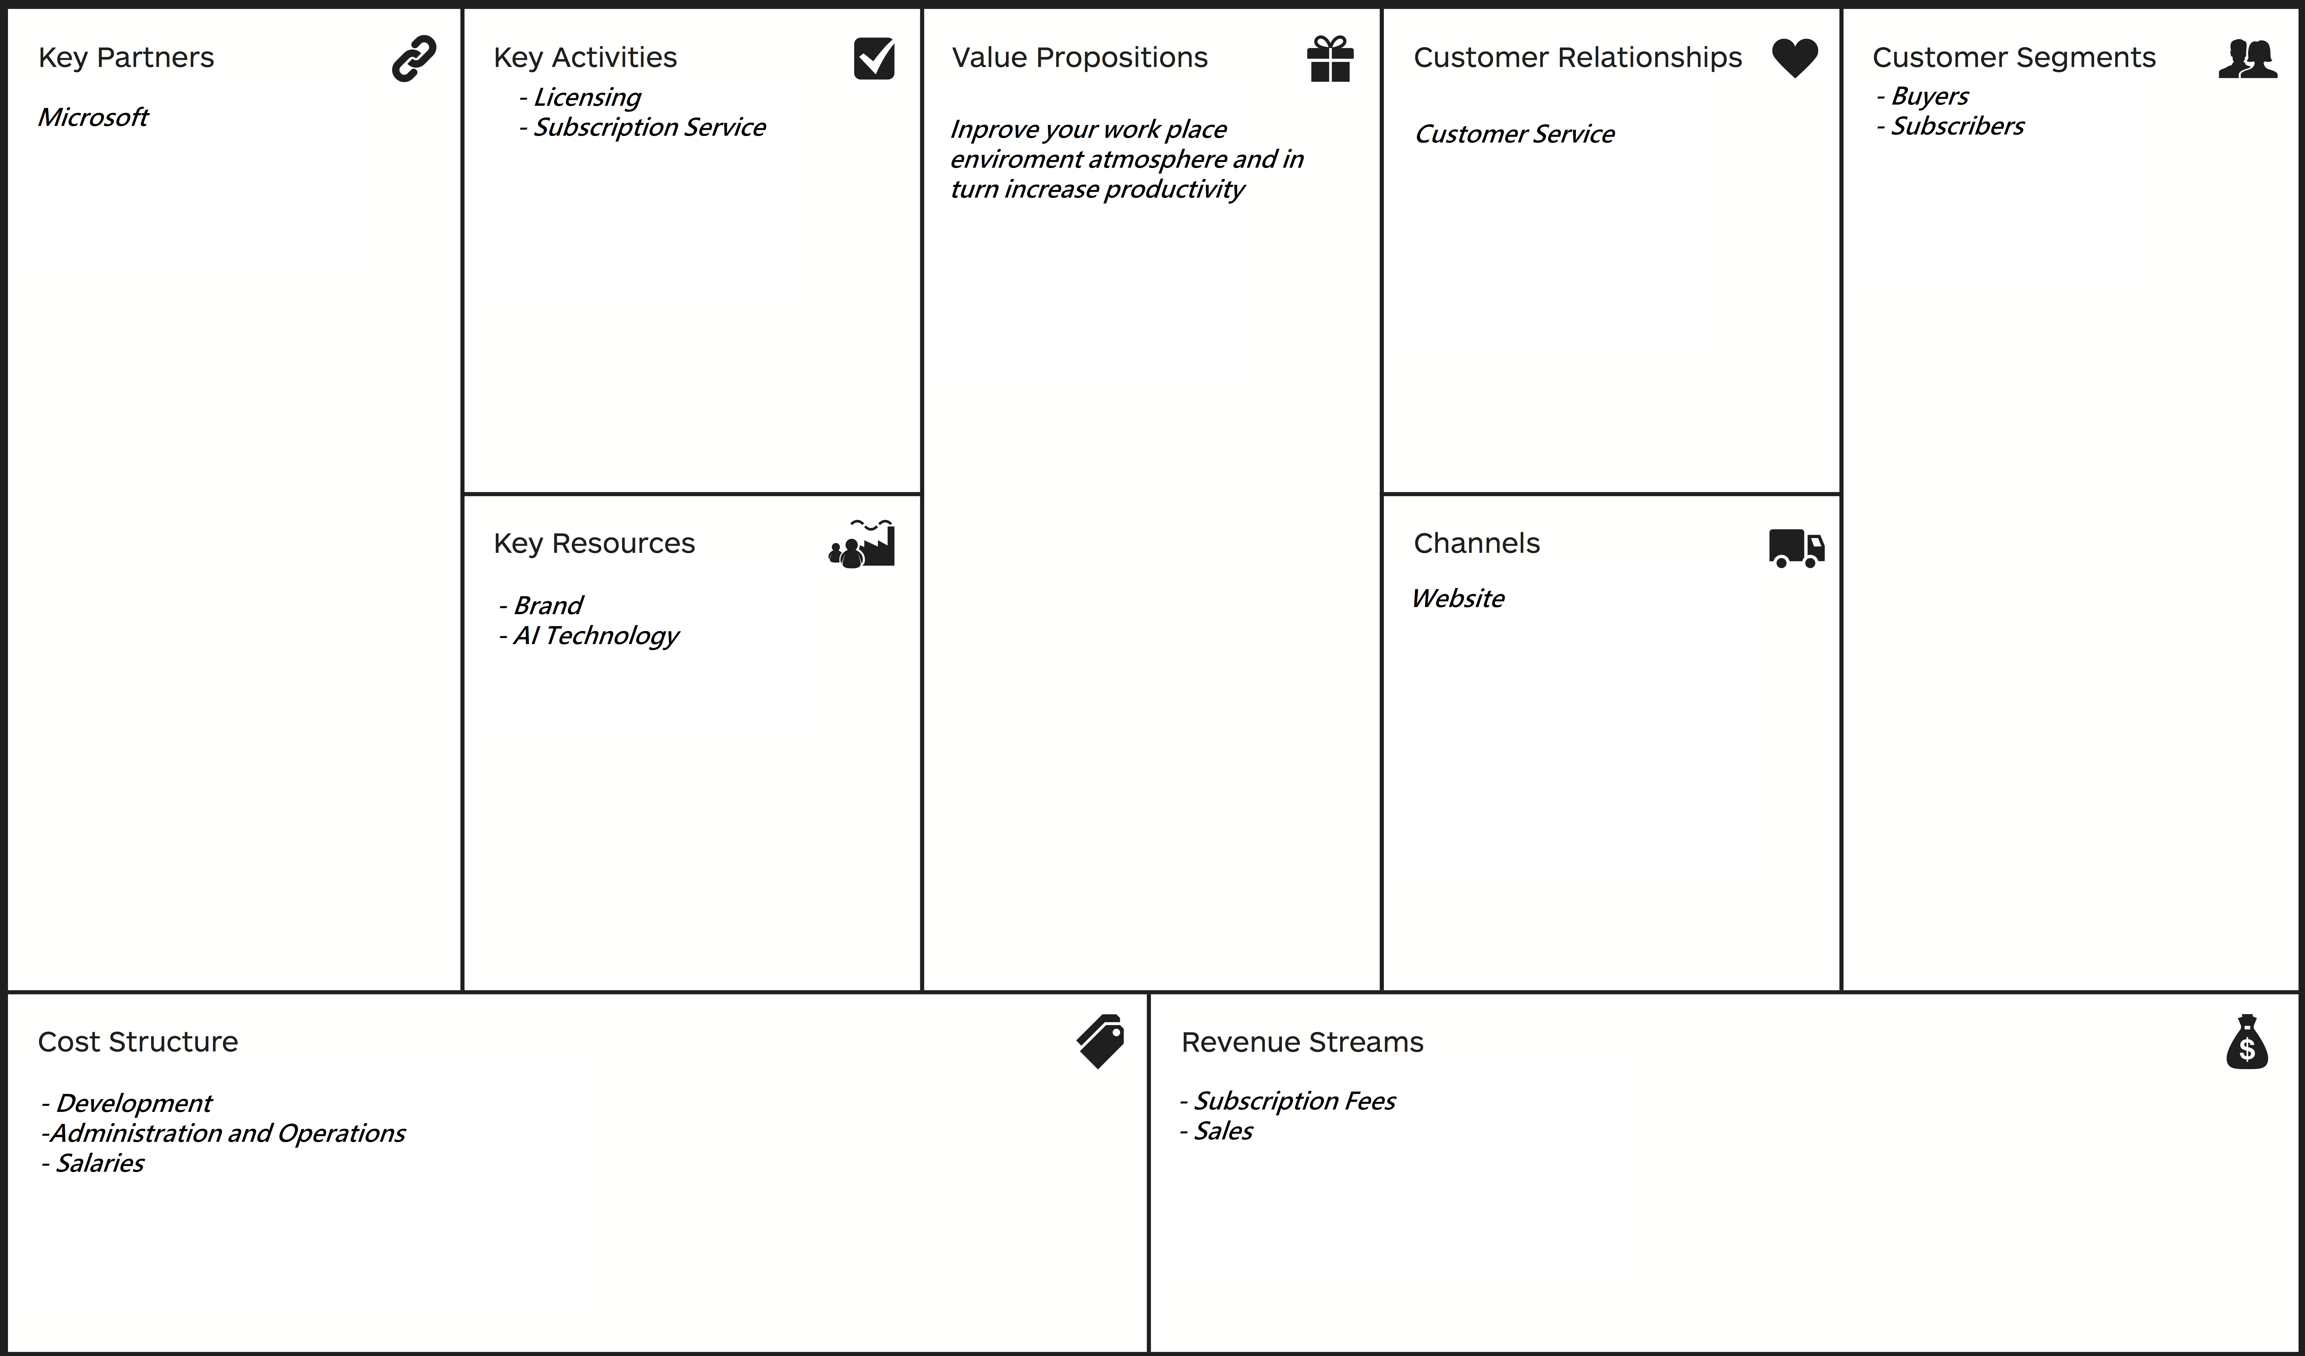
VALUE

Slide 10
Executive summary
An easy access Chatbot App for Employees to complain or give positive recommendations about their coworkers...
In case of a complaint, the AI gives back specific personal (Emotional support ) and formal ways to proceed.
The App gathers anonymous Data and turn it to a valuable information that will help the companies raise their productivity …
‘ Sophi. Play ’ is a Gamified challenge to train/test and educate the employees.

